Slide 1
Coursera Capstone Project – The Battle of Neighborhoods
Comparing Boroughs from Lima and Toronto Cities

Slide 2
Data Science Capstone Project
For the Data Science Capstone project, a comparison between the cities of Lima (Peru) and Toronto (Canada) will be performed, leveraging the Foursquare location data.
The objective of the project is to compare the boroughs of Lima and Toronto cities and determine how similar or dissimilar they are.

Slide 3
Source of the data and tools
Toronto boroughs and neighborhoods data source: https://en.wikipedia.org/wiki/List_of_postal_codes_of_Canada:_M;
Lima boroughs data source: https://www.antipodas.net/coordenadaspais/peru/lima.php#coordenadas;
Beautiful Soup library to scrape information from web pages;
Folium library to map boroughs and neighborhoods;
Foursquare API to get the most common venues given the coordinates of each location.

Slide 4
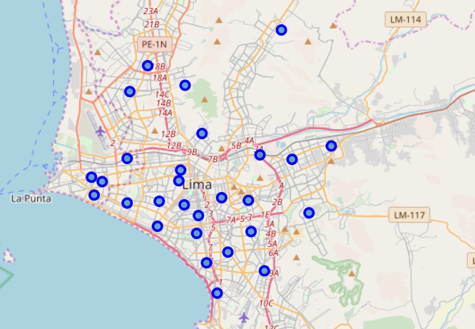
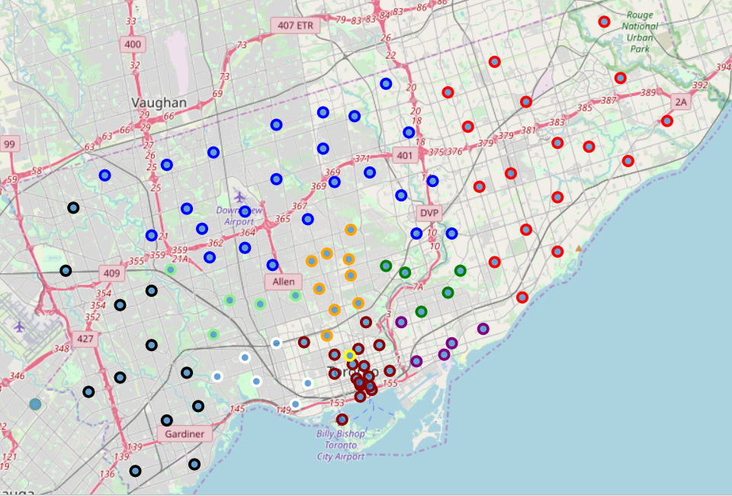
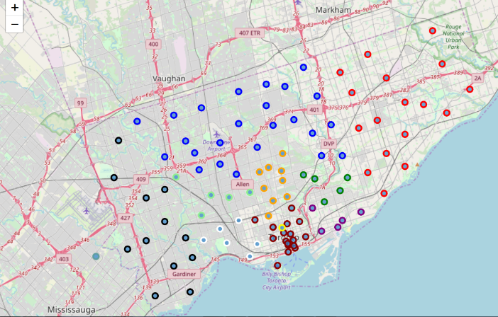
Lima and Toronto boroughs
Beatiful Soup library was used to scrape the web pages to get data from Lima and Toronto.
Folium library was used to map Lima and Toronto cities.
Toronto boroughs were mapped using different colors to better understand its distribution within the city.

Slide 5
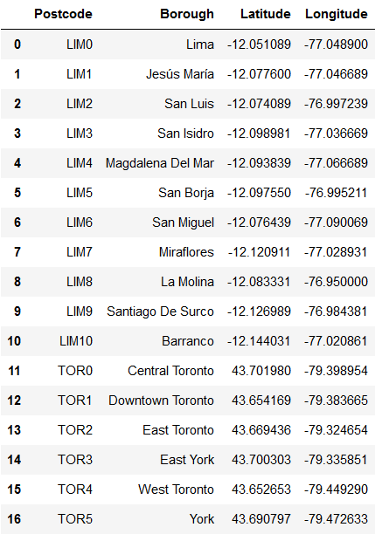
Lima and Toronto dataset
The data from Lima and Toronto was cleaned, reordered, and merged.
Relevant boroughs from both cities and their coordinates were selected for this project.
The dataframe shown at the right was used for further analysis.

Slide 6
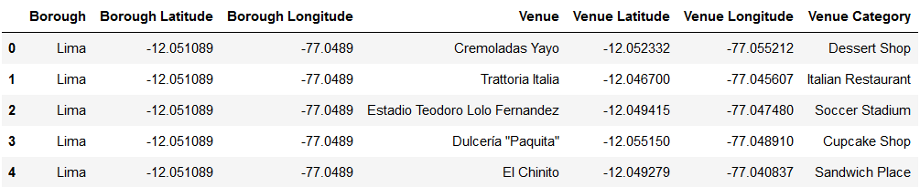
Leveraging Foursquare location data
Boroughs coordinates were used to get venues using Foursquare API.
API parameters were set to Limit 100 venues by location and search in a Radius of 1500 m.

Slide 7
Initial Clustering for Lima and Toronto boroughs
K-means algorithm selected for clustering boroughs.
Elbow method used to determine optimal number of clusters (k) for K-means, but no definitive ‘elbow’ was identified.
The number of clusters set for the analysis was k=3.
Results of the initial clustering is shown in next page.

Slide 8
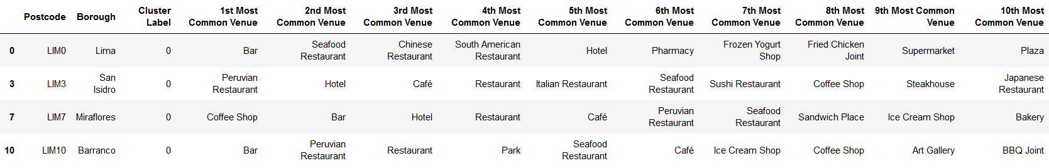
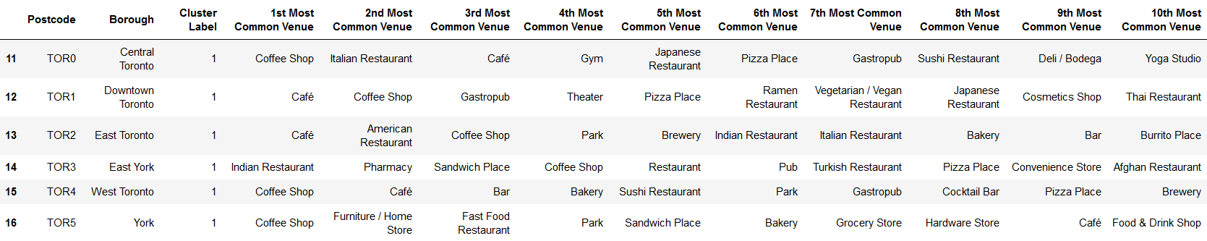
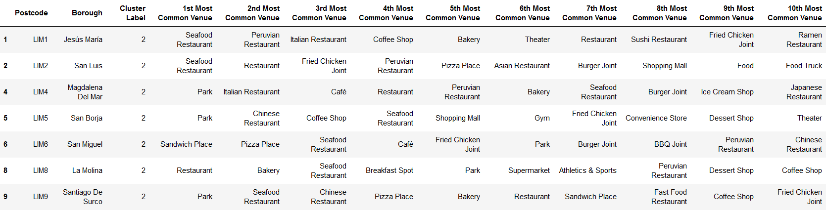
Cluster 0
Cluster 1
Cluster 2

Slide 9
Analysis of initial Clustering
A pattern from previous chart is that boroughs from the same city are grouped together:
boroughs from Lima are in Clusters 0 and 2;
boroughs from Toronto are in Cluster 1.
Other pattern is that most common venues in Clusters 0 and 2 are Restaurants in Lima, while in Cluster 1 are Café and Coffee Shops in Toronto.
A bar chart in the next pages will help visualize better the top venue categories in each city.

Slide 10
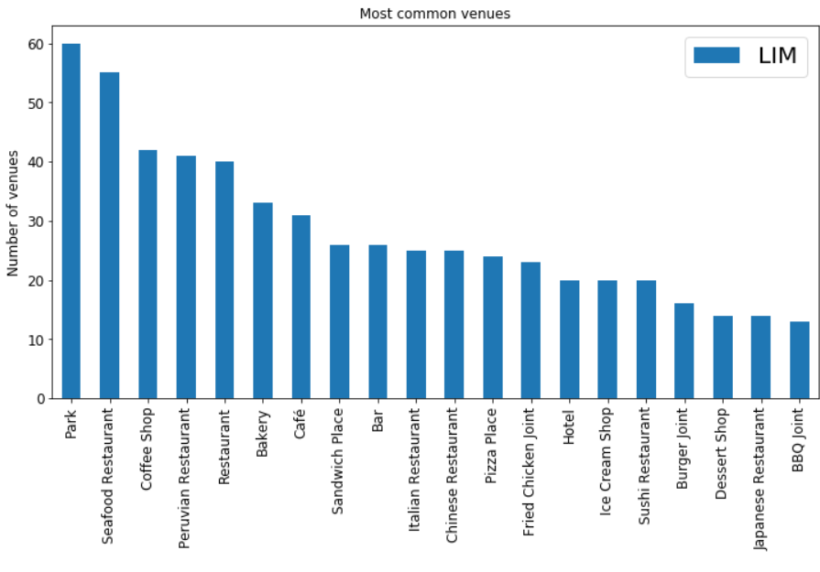
Lima: top 20 most common venues
‘Park’ venue is the highest in Lima.
But combining all kinds of ‘Restaurant’ venues is greater than the ‘Park’ number of venues and represents 30% of all venues.
Also ‘Cafe’ and ‘Coffee Shops’ gives a greater number than the ‘Park’ venue and represents 8% of all venues.

Slide 11
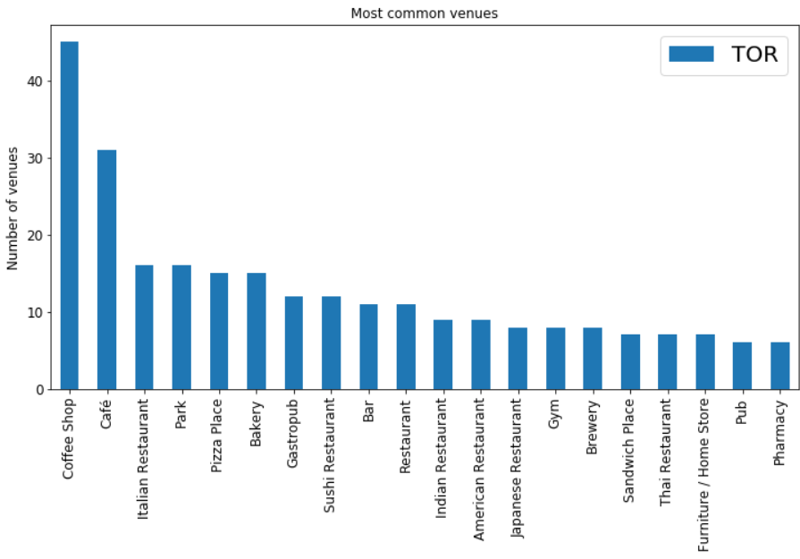
Toronto: top 20 most common venues
‘Café’ and ‘Coffee Shops’ venue categories are the highest in Toronto, which represents 16% of all venues in Toronto.
When grouped together, the ‘Restaurant’s venue categories represents 26% of all venues.

Slide 12
Final Clustering for Lima and Toronto boroughs
The big proportion of Restaurants, Café and Coffee Shops seems to be a determinant factor when generating clusters using K-means algorithm.
A second run was done excluding these venue categories in both cities.
Results of the final clustering is shown in next page.

Slide 13
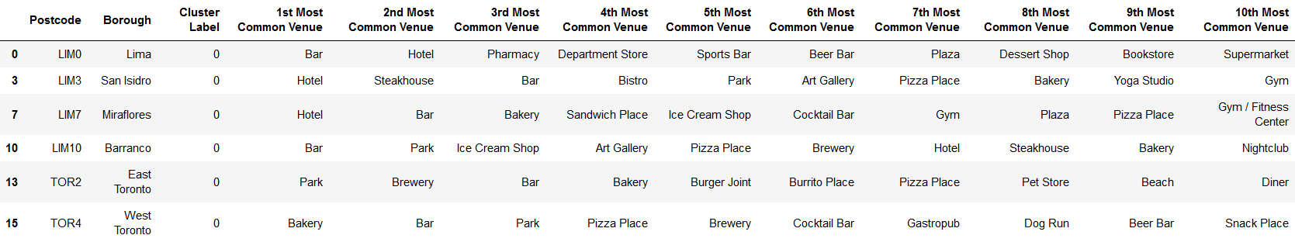
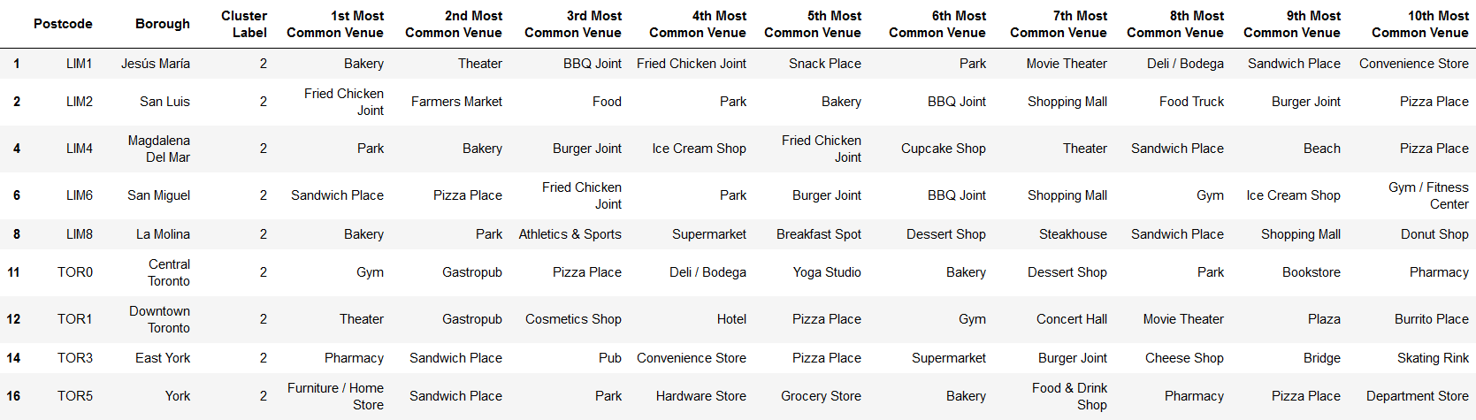
Cluster 0
Cluster 1
Cluster 2

Slide 14
Analysis of final Clustering
Looking to the previous charts with the final clustering results, we observe that:
Cluster 0: Lima, Miraflores, San Isidro and Barranco were grouped together with East and West Toronto, close to my expectation, as these are known as tourism centers. The most common venues in this cluster are Bars, Hotels, Bakeries, Breweries, Parks.
Cluster 1: the main driver seems to be the Parks venue category.
Cluster 2: might be grouping several venues where there is no a predominant one.

Slide 15
Final Observations
Excluding the Restaurants and Café / Coffee Shops venue categories for the final clustering, does not diminish the importance of the excluded two categories, as they are a very important aspect of Lima and Toronto cities.
In excluding the Restaurants venue categories for the final clustering, it became obvious that other venue categories may be grouped together, e.g.: Fried Chicken Joint and Burger Joint can be grouped as Fast Food. This will have the K-means algorithm to provide different results, but explanation might be easier.
The random_state and the number of clusters must be set for the K-means algorithm to run; a different initial setup may give different results.
The model is conditioned to the data accuracy provided by Foursquare. Parameters that can change the results are the number of venues which was limited to 100 for this project, and the radius or distance to be searched from the borough locations. These two parameters might be adjusted to get more precise results if needed.

